Slide 1

Corporate Travel and Expense management System

Slide 2
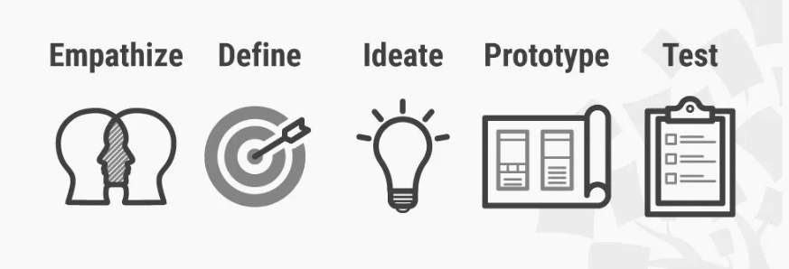
Product Information
Product
A platform that enables employees to communicate their travel plans to their manager for approvals and notify travel helpdesk.
Channel
website
Target
A mid sized company with branches around the world .It expects its employees to travel between the branches ,to sales meetings, conferences and so forth.
Stanford D school – Design Thinking Model

Slide 3
Stanford D school – Design Thinking Model
Step into user shoes , understand the situation and customer`s problems.
Challenge assumptions and create ideas. Think outside the box and come up with large number of ideas.
Evaluate your prototype with the user. Use the results to redefine one or more problems.
I have chosen Stanford D school design thinking model as it is easy to understand and be applied.
These 5 steps design thinking process helps tackle ill-defined and unknown problems as they can reframe this in user centric way and focus on what`s important for the users.
As it is a non-linear and iterative process it helps us to challenge assumptions, redefine problems and create solutions to prototype and test.
Analyse your observation and synthesize them to define customers needs and problems
Create a solution (prototype) of the idea in order to test with user

Slide 4
Design methodology at each stage of the design thinking phase
These methods were used at each stage of the design thinking stages in order to define problems and design user centric solution.
Empathize
Define
Ideate
Prototype
Test
Pain Gain Analysis
Jobs to be done
Pains customer face
Gains created for customers from the solution
User Persona - This will give us an understanding of the targeted users.
Demographics
Behaviour, aspirations
Challenges
Mind Mapping technique – This method was used to jot down all the ideas.
Define central phrase
Write down anything that comes to mind
Establish relationship between the entities
Paper Prototype
Feedback capture cards
Customers was asked to test the prototype and record their likes,criticism,questions,ideas .

Slide 5
Empathize - Pain Gain Analysis
Jobs to be done
One stop solution for the employees to make flight and hotel bookings.
No dependency on travel desk to get approvals that eliminating delays.
Manager to approve the travel requests keeping track of budget.
Book flights and hotels for specific dates as per companies budget.
Get managers approval for travel expenses.
Notify Internal travel desk about the travel arrangements after manager`s approval.
Gains
Pains
Travel desk is backed up with pending travel requests.
Dependency on travel desk for booking arrangements may delay .
Employee may not get preferred accommodations .

Slide 6
Pain Points
Travel desk is always backed up with pending travel requests that might delay the process.
Delay in seeking approvals for budget and per diem
Employees may not get preferred travel and hotels as it is booked by travel desk.
There is no mechanism to know the budget cap for the travel expenses until it is rejected or communicated by helpdesk

Slide 7

Define – User persona (Employee)
Persona created post insights from pain gain analysis
Behaviour
Participate in all the sales meetings and conferences for his professional growth.
Strive to perform well and be successful.
Aspirations
Build reputation and stand out at work.
To get important assignment and accounts to establish a deal.
Be comfortable during the business travel.
Goals
Be recognized for completing important assignments
Career growth in couple of years
Build a strong portfolio with diverse experience
Challenge
Travel frequently for client meetings and conferences at short notice.
Co-ordinate with the internal travel desk for the bookings , time consuming and over head.
Unable to get preferred accommodation and flights as it is handled by travel desk.
In case of delays cannot call out these inefficiencies with the customers .
Demographics
Name - Prithvi
Age - 32
Gender - Male
Location - Bangalore
Occupation - Senior Sales Executive
Income - 12 LPA
Experience – 8 years
Prithvi is a sales professional in a mid sized automotive company, They have branches and manufacturing facilities around the world. He has 8 years of experience in sales and customer relations. He frequently travels between branches and manufacturing facilities for conference , workshops and sales meetings.
Prithvi is a smart sales professional and has been recognized for successfully executing large sales deals which has helped his company to grow in past 3 years .His ambition is to perform well in the coming sales deals and excel as a professional.

Slide 8
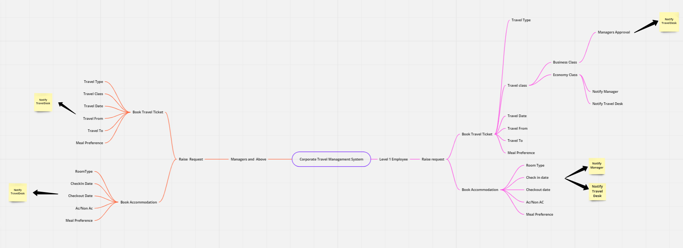
Ideate – Mind Mapping Technique

Slide 9
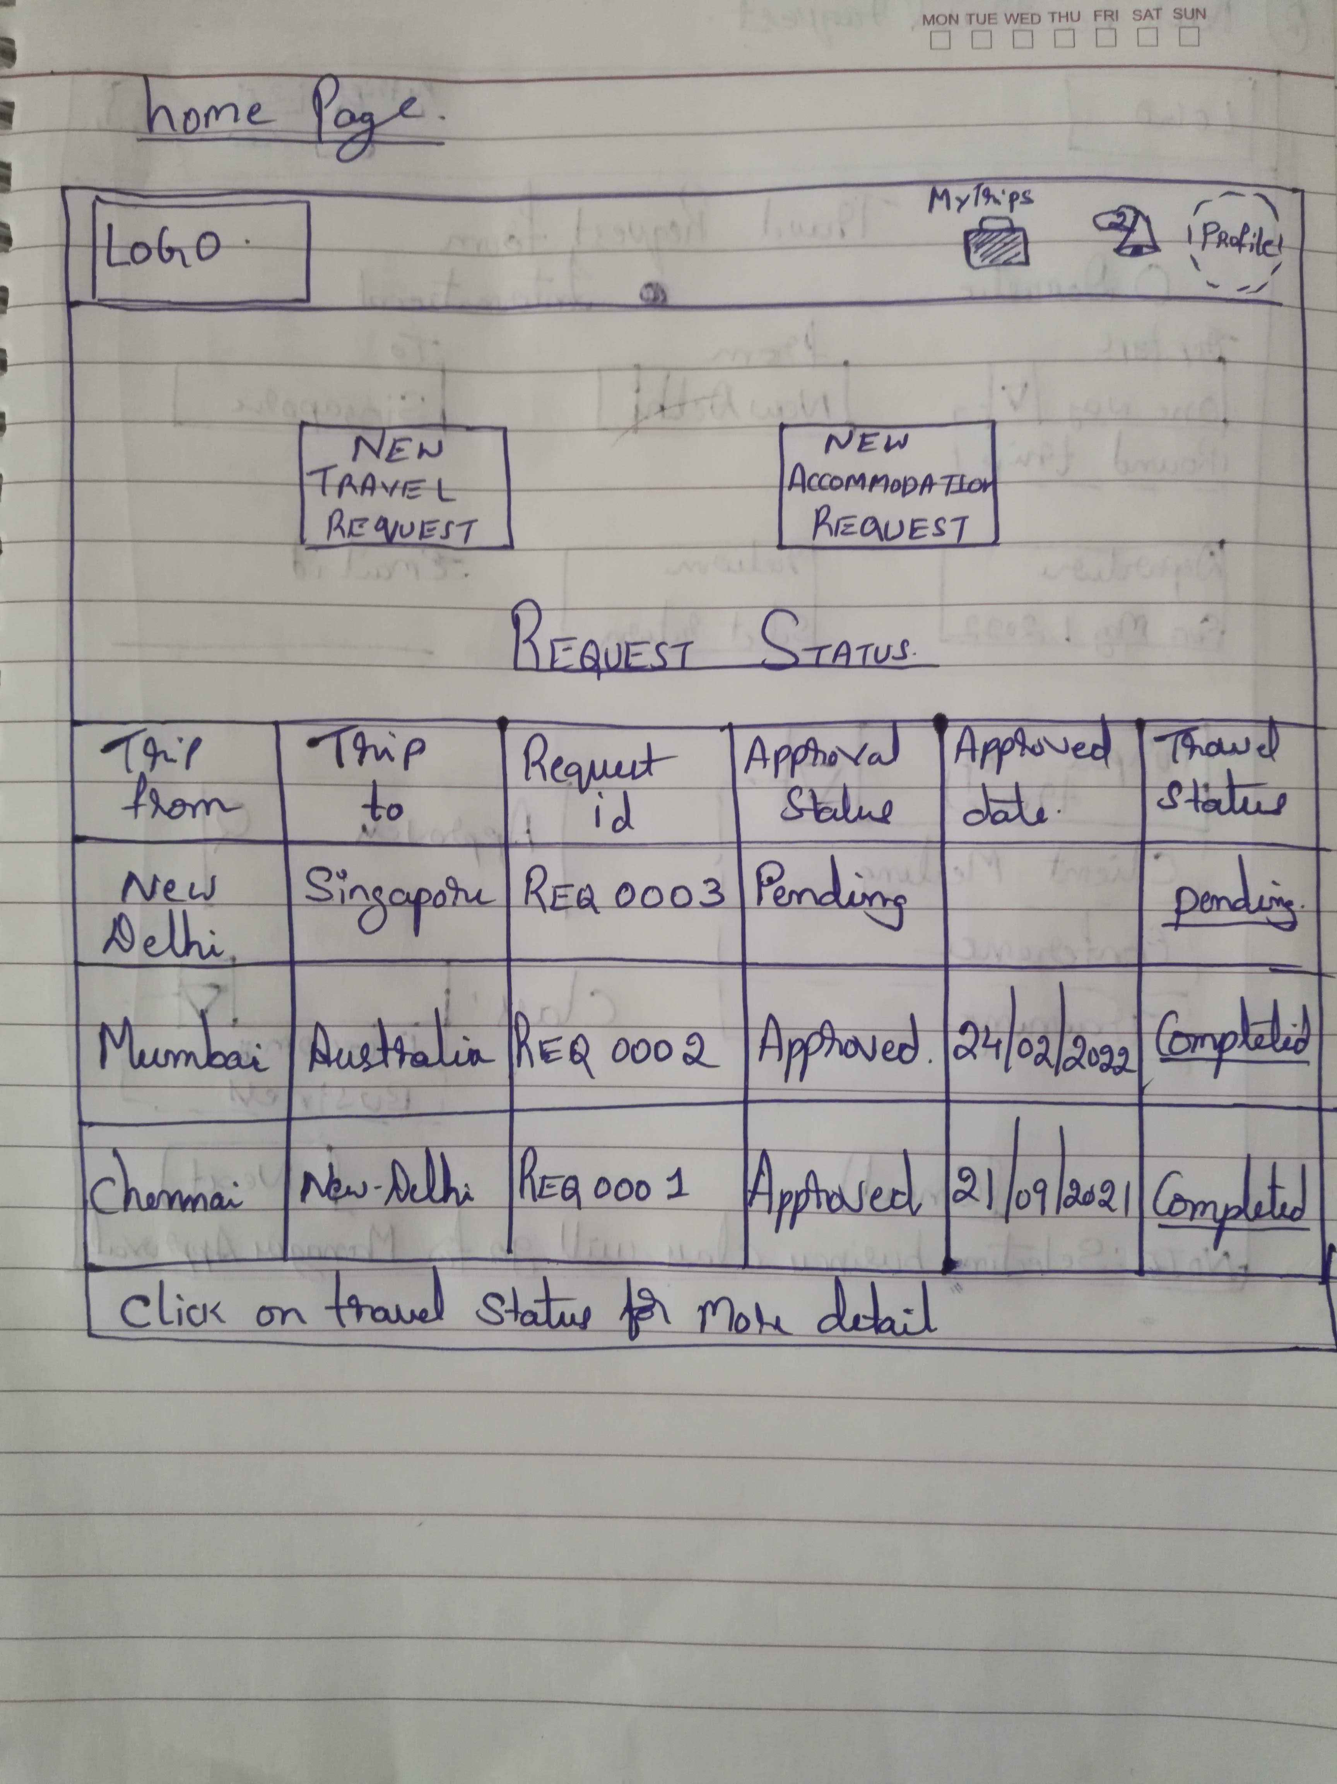
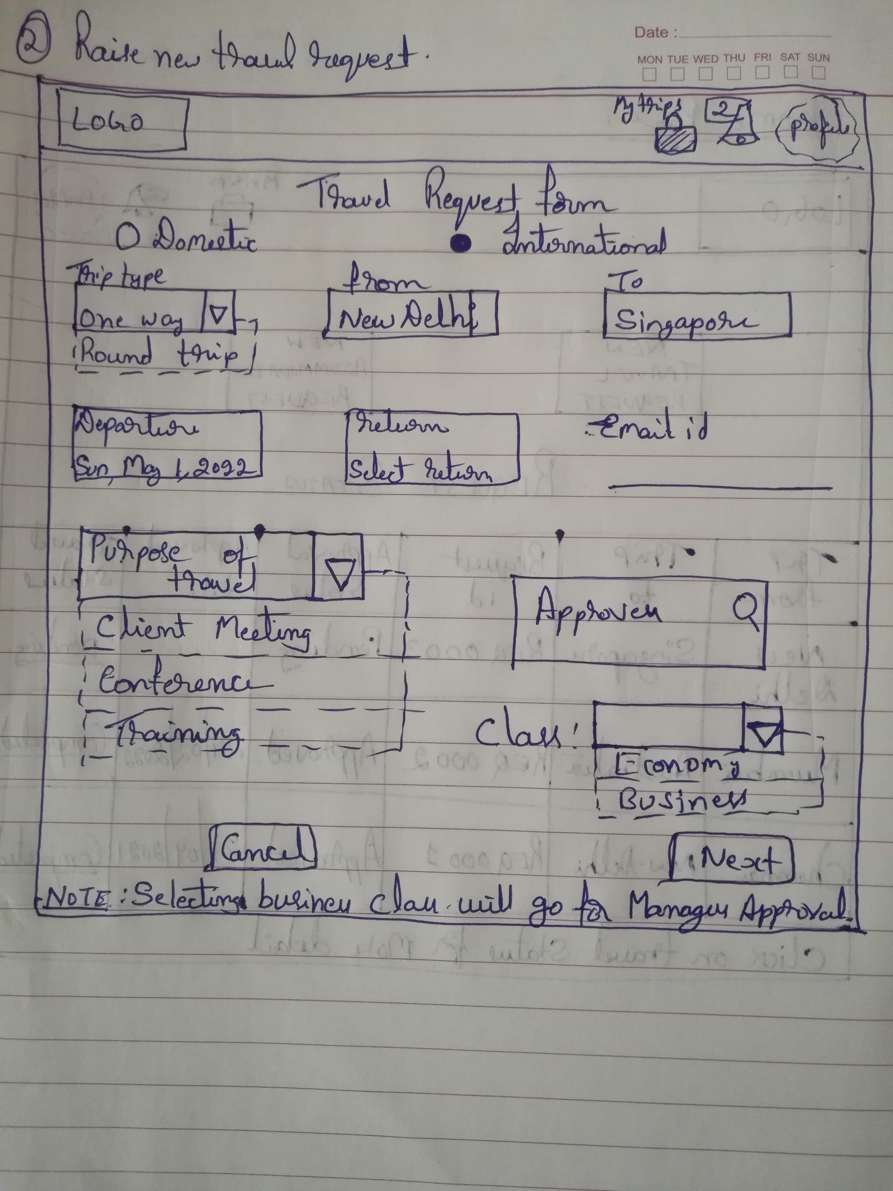
Paper Prototype
User clicks on New Travel request which renders this form for the user to fill in details required and click Next
If user selects class to be Business then his request would be sent for managers approval.
This is the home page of Corporate Travel Expense System. When user enters his credentials through SSO upon authentication he will land here.
There are 2 separate cards to Raise new travel and accommodation requests.
This page also shows the users previous requests and its status.
Home Page
New Travel Request Page 1

Slide 10
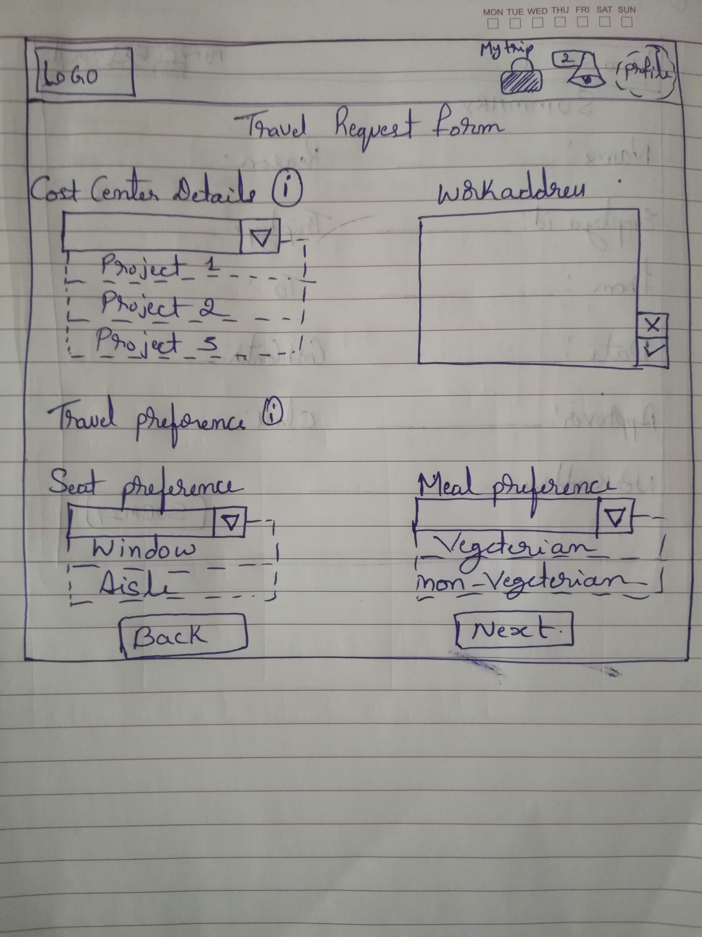
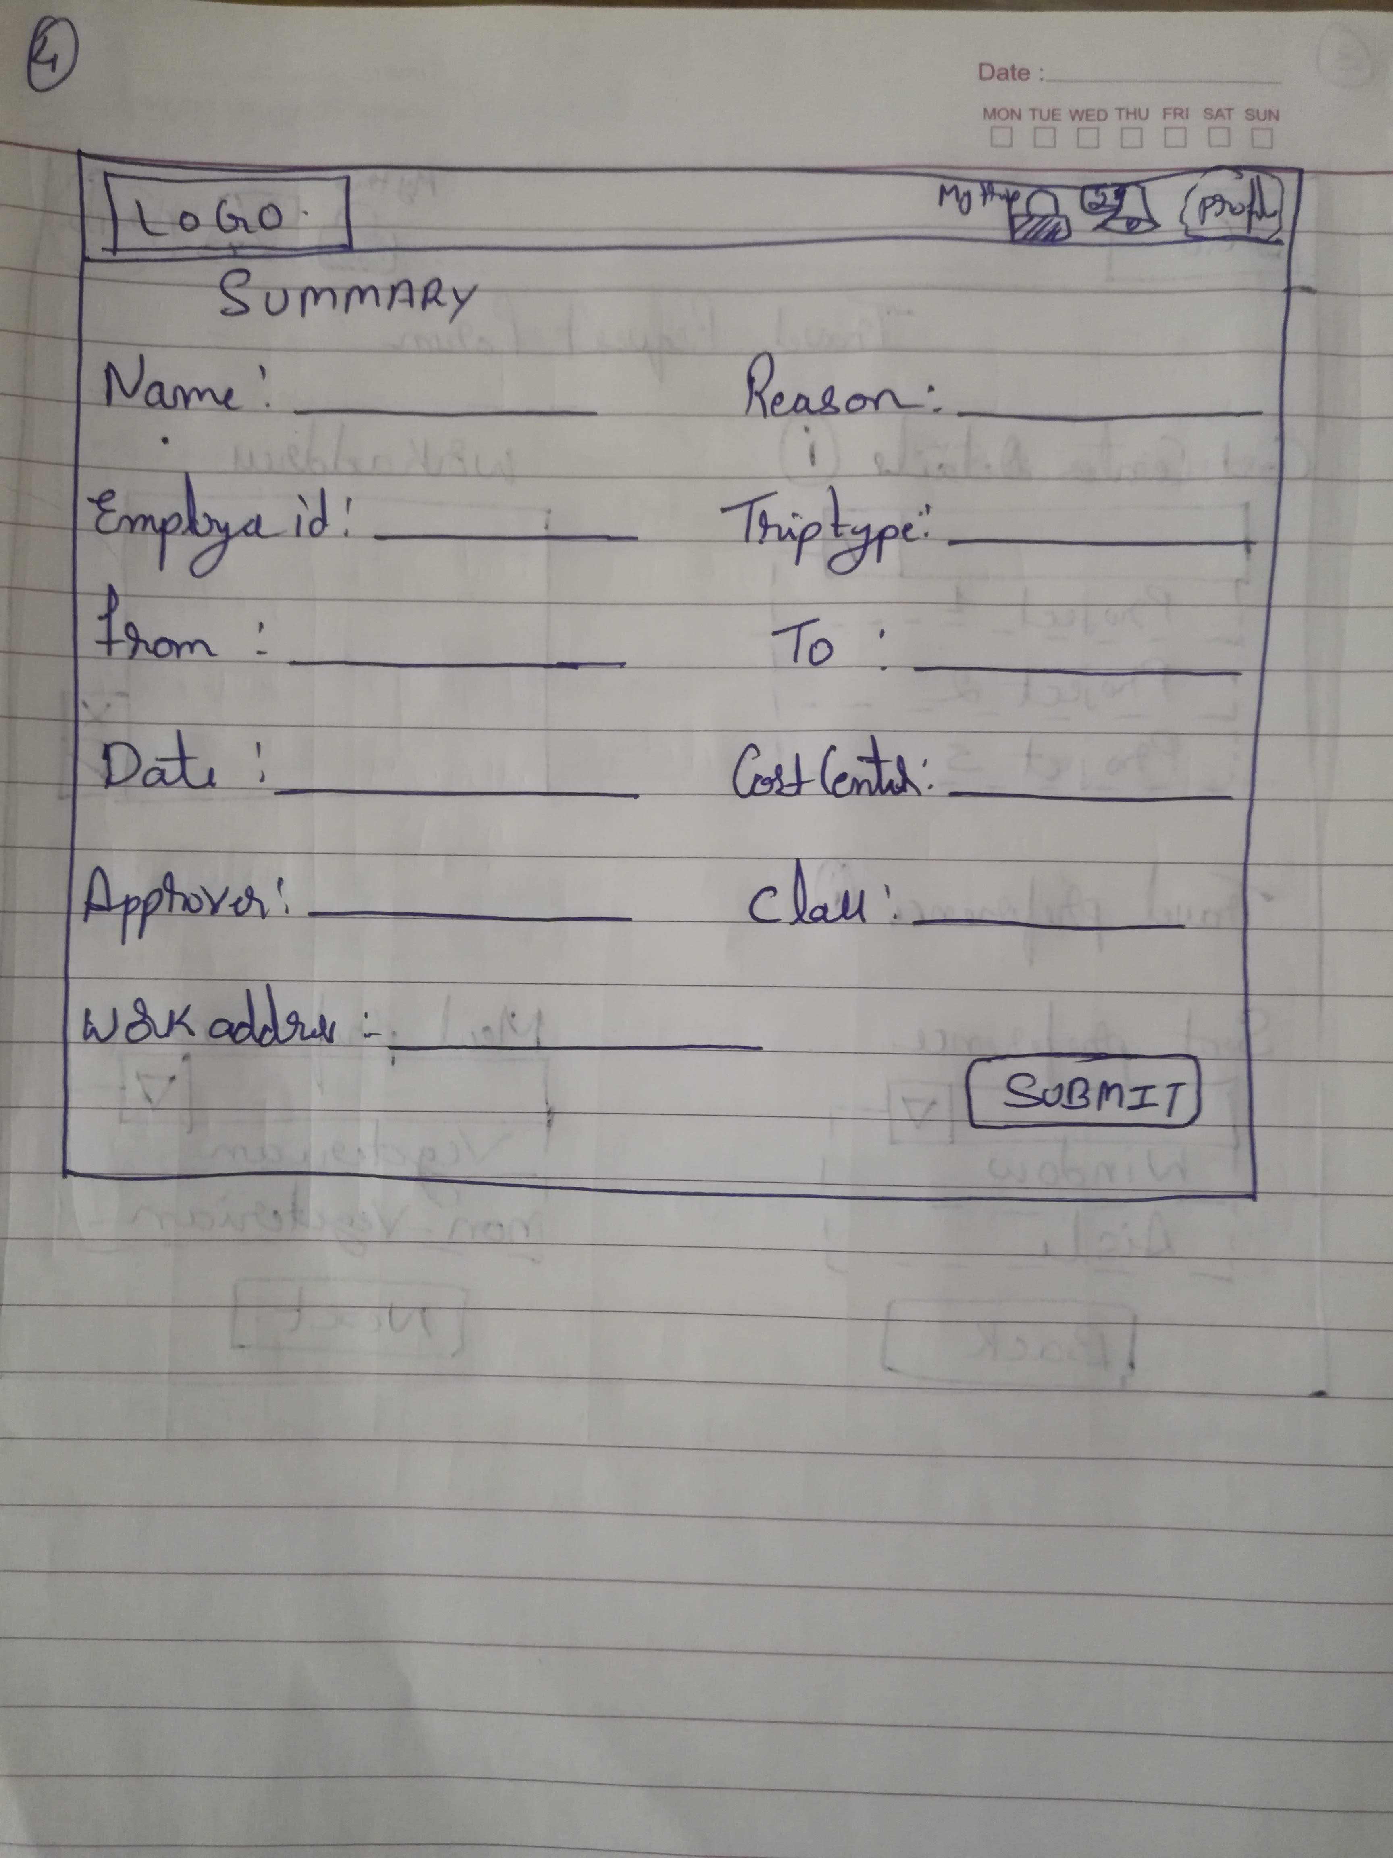
Paper Prototype
This is a summary page that provides user with all the details that has filled in order to review .
Once user review`s he can click the Submit button which would send a notification to Travel desk and if the user has selected Business Class to travel another notification will be sent to manager for approval.
If the user has selected Economy class for travelling he will be redirected to flight search page
This is Page 2 of the New Travel request user needs to fill in the details and his travel preferences and click Next to proceed or click Back button to go back to the previous screen
New Travel Request Page 2
New Travel Request Summary

Slide 11
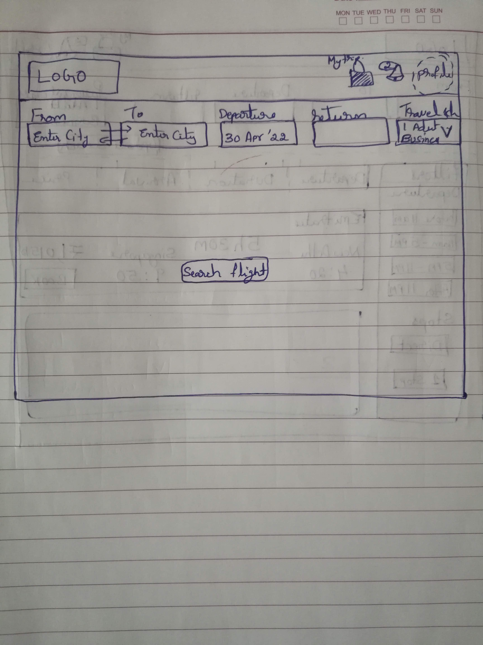
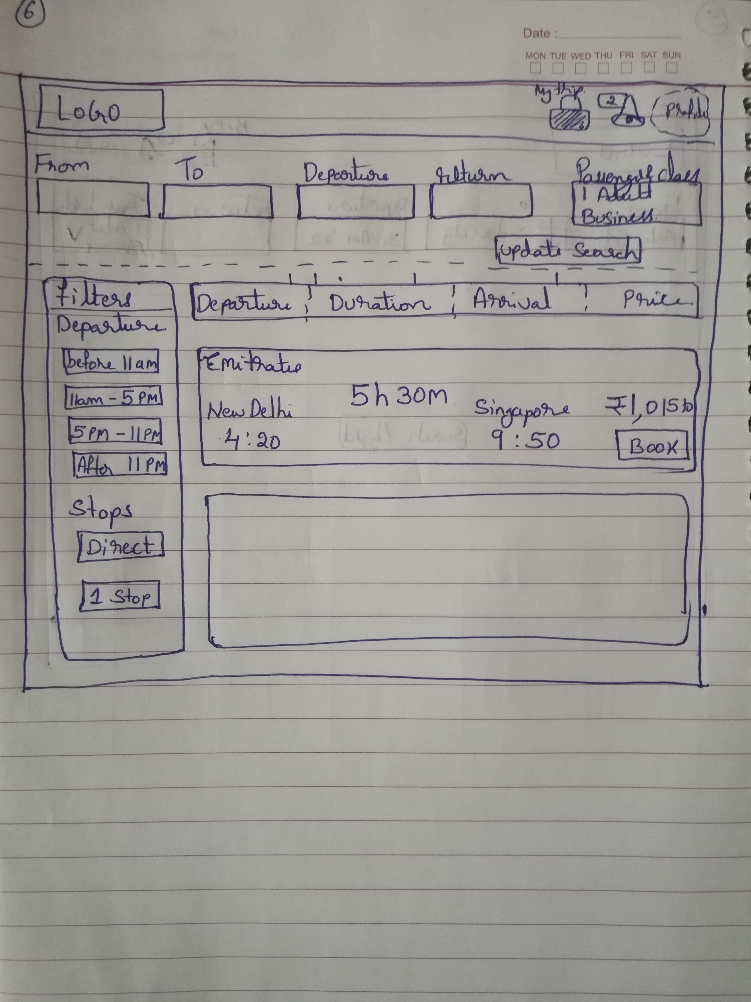
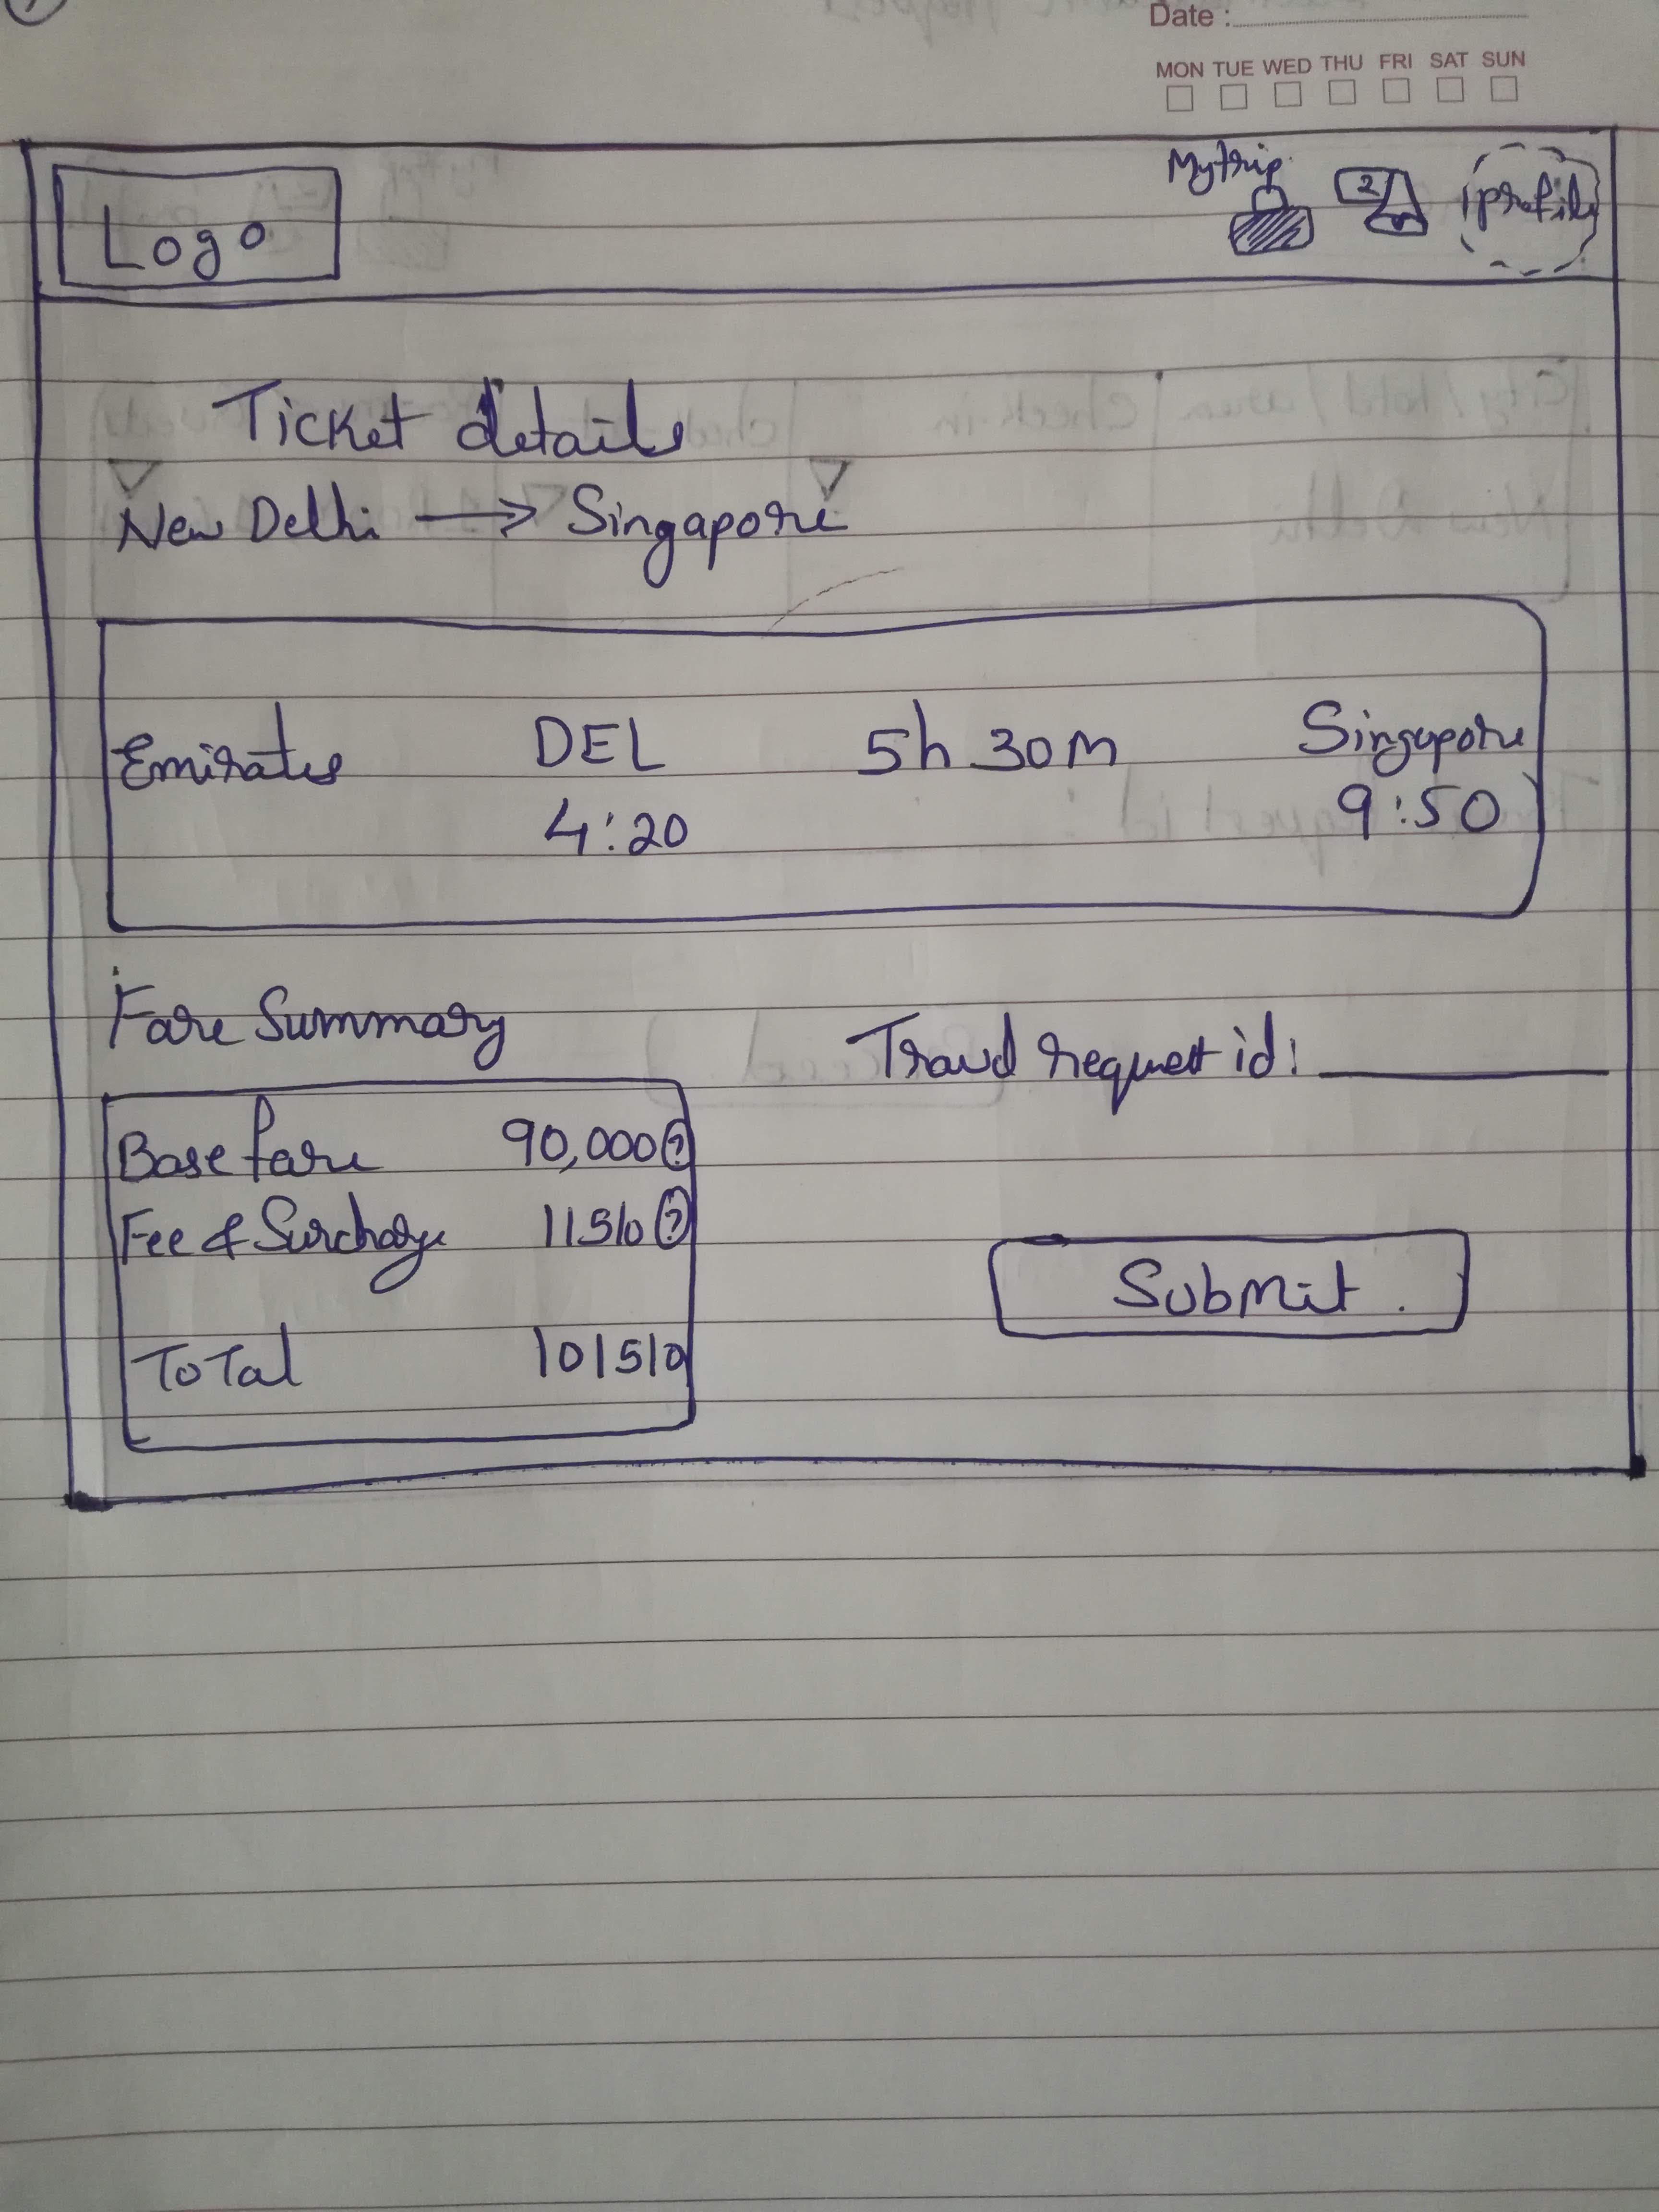
Paper Prototype
Flight Search
Search Results
Travel request Summary
If the user has selected Economy class he will be redirected to this flight search page which will allow to search based on criteria.
If the user has selected Business class to travel it goes for managers approval and once it is approved user can click on Travel Status in the request status of the home page to get to this page.
This is the page that lists out the available flights along with time and other details. User can review the options, filter based on criteria and click on Book button to the next page.
This page enables user to review his flight details and price. Upon clicking the submit button a notification will be triggered to travel desk for further action .

Slide 12
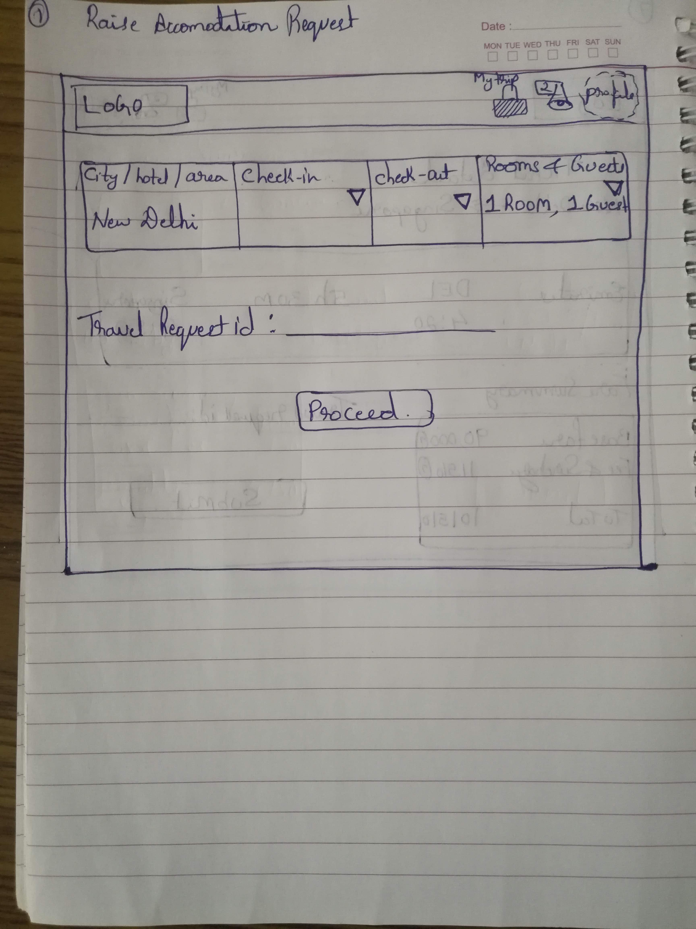
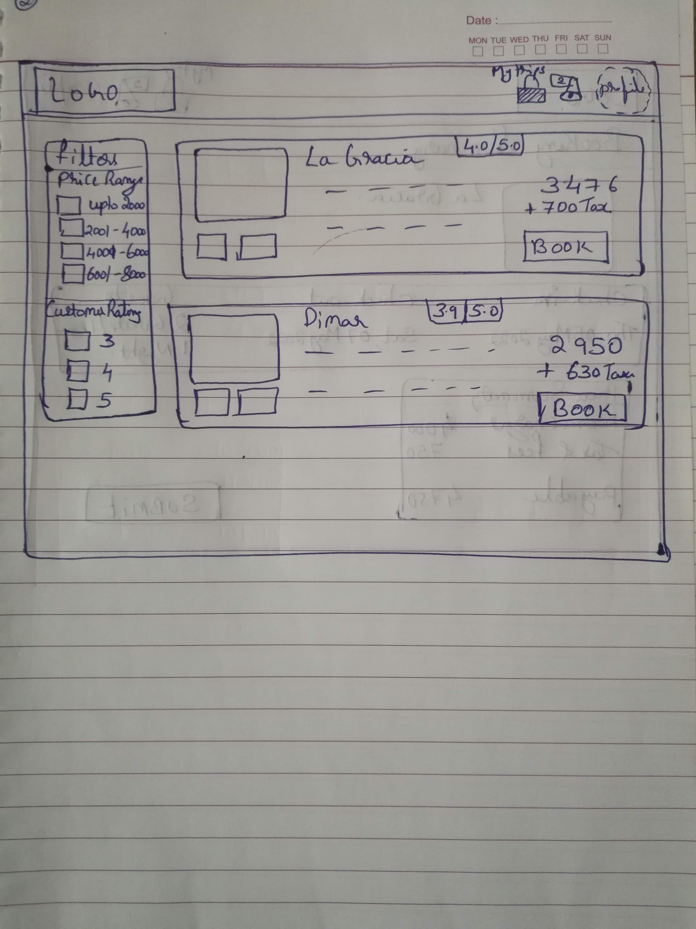
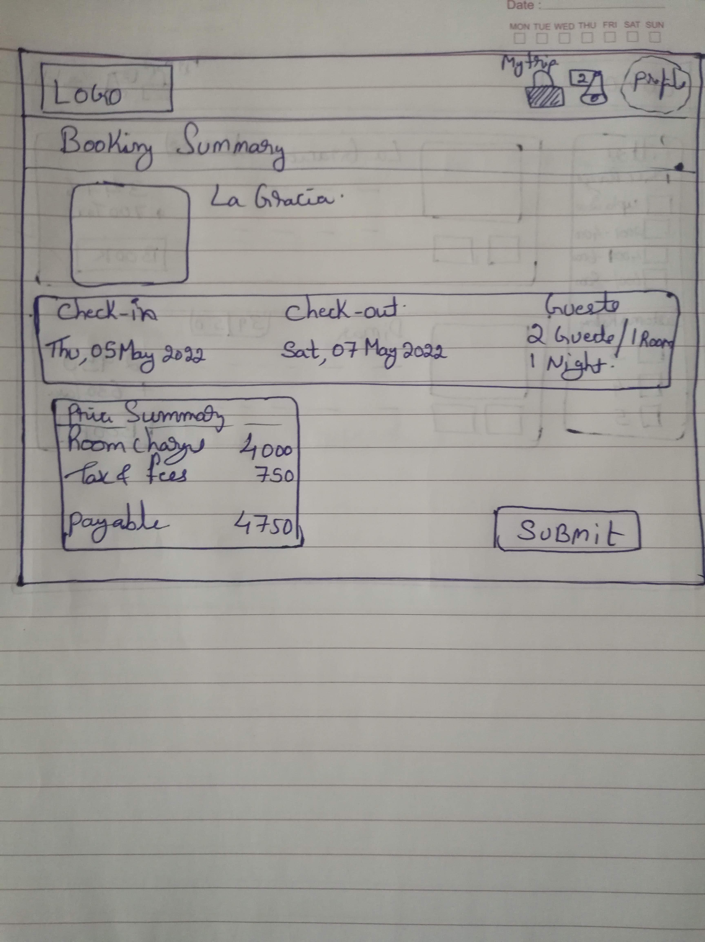
Paper Prototype
New Accommodation Request
Search results
Accommodation request Summary
User clicks on New Accommodation request and will be taken to this page to fill in preferences along with the Travel request ID to search and provide results.
This page provides the users with accommodation options to review , filter based on the criteria .
Once user clicks on the Book button he will be taken to the next page.
This is a page for the user to review accommodation selected from the previous page along with the price details.
Once user reviews and clicks on submit button a notification will be sent to travel desk and this travel request will be associated with the Travel request ID entered by the user.

Slide 13
Test – Moderated User Testing
This prototype was validated with one of the user who works as Security Auditor in an IT services company. Her role demands frequent travel for which the planning is done by internal travel desk. Moderated user testing method was used to test this prototype and received some feed backs and has documented the users likes, dislikes and ideas to enhance the product.
Users Likes
User likes the process flow through which all the information regarding travel preference is captured and has eliminated the dependency on internal travel desk.
Users dislikes
In case an approver is not available user is not able to modify and provide alternate approver.
User has to enter travel request number and email id which she wants to auto populate in the process flow.
Some of the pages does not have provision to go back to previous page if she wants to edit some things.
Provision to cancel request and edit request is not available.
Ideas
Travel options is limited and should include train and road travel.
Provide escalate approval option to route the request to alternate approver.
Provide an option to cancel requests.

Slide 14
User Insights and Define user Problems
Considering the likes, dislikes and ideas from the user testing below mentioned features can be added to enhance the product
Provide an option to choose train and on road as option for domestic travel.
Provide an option to cancel and edit the request until it is approved.
Provide an option to add multiple approvers and elevate approver.
Fix navigation back to the previous page.
Capture travel request id and auto populate where ever required to minimize user inputs in all stages.

